Slide 1
DR2.1 Representing Data
Data Representation
Andrew.Beatty@atu.ie

Slide 2


Many Different ways to represent DATA
In Software
Variables, Lists, Dicts, Numpy Arrays, etc
Pickle (Serialised Software data structures)
As a Table
Excel (in a file)
SQL Database tables (in a file)
CSV file (human Readable)
As a Text file
Simple Text file
JSON
XML
Lots of other
Charts (there is a whole area on Data Visualisation)

Slide 3
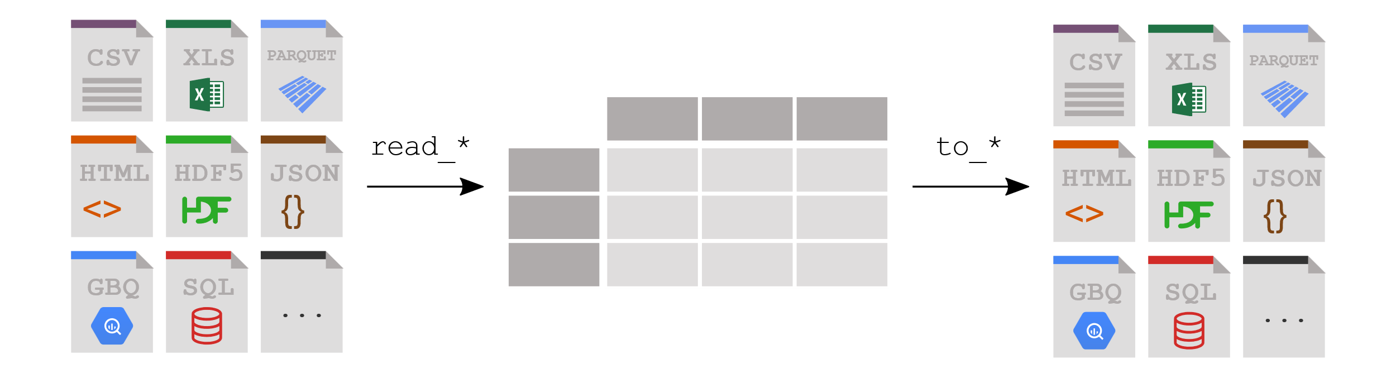

Remember PANDAS

Slide 4
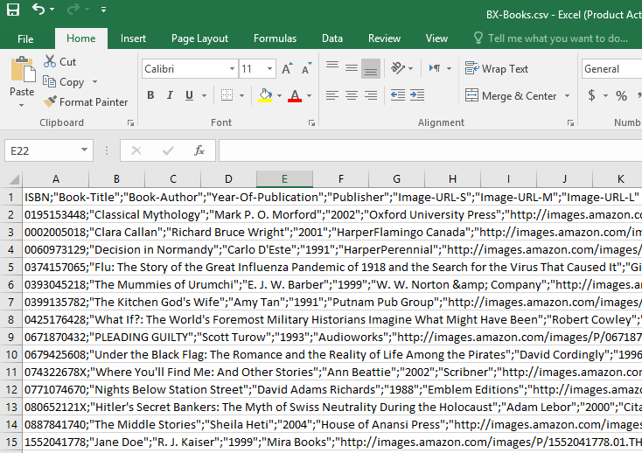
CSV

Slide 5
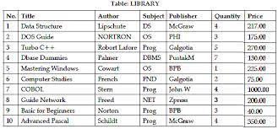
SQL

Slide 6
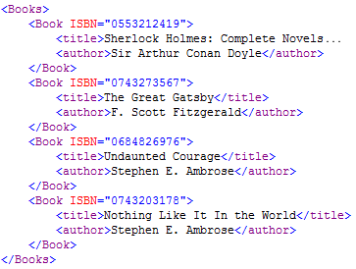
XML

Slide 7
JSON
{
"Books":
[
{
"Title":"the order of the pheonix",
"Author":"JK Rowling",
"ISBN":"1234556677",
"Price": 199
},
{
"Title":"The Goblet of Fire",
"Author":"JK Rowling",
"ISBN":"1234556678",
"Price": 199
},
{
"Title":"Data representation course",
"Author":"Andrew Beatty",
"ISBN":"1234556679",
"Price": 10000099
}
]
}

Slide 8
Some Attributes to think about
Human readable or not
How is the data organised (e.g. flat-table vs nested)
This matters when you are storing more then one entity type
Ease of modification (updating)
Efficiency of space (especially for transmission on a network)
Robustness

Slide 9
We will be looking at XML and JSON
Human Readable
Simple
Compact
Nested
Well standardised

Slide 10
One (MANY) to One….. One (MANY) to Many
Think about how you store many entities that have relationships in a CSV, Excel table or SQL table
One (Many) to one: Store a person and address
Personher
Address
How
Embed (one to one)
Foreign key (many to one)
Name (Primary Key) | Date of Birth | Other | Other
Andrew | 01/01/1970 | Blah | Blah
Address_id | line1 | city | Other
1 | 3 hillside | Gort | f278832

Slide 11
Storing a person and their address
One to one embed
Name | DOB | line 1 | City
Andrew | 01/01/1970 | 4 cresent drive | Westport
Joe | 02/02/1980 | 20 snowdrop hill | Darndale
Mary | 03/03/2000 | Cregg Manor | Dalkey
Many to one by foreign key
Name | DOB | Address
Andrew | 01/01/1970 | 1
Joe | 02/02/1980 | 2
Mary | 03/03/2000 | 1
id | line 1 | City
1 | 4 cresent drive | Westport
2 | 20 snowdrop hill | Darndale

Slide 12
One (many) to many
For example students and their modules
Student
Module
How could you connect them
Reverse the relationship and use Foreign key in the modules
Have a bridging table
In software you would use an array.. So you can with XML and JSON
Name (Primary Key) | Date of Birth | Other | Other
Andrew | 01/01/1970 | blah | blah
Name (Primary Key) | Credits | Other | Other
Math | 10 | blah | blah

Slide 13
One to many reversed
Name (primary key) | DOB
Andrew | 01/01/1970
Joe | 02/02/1980
Mary | 03/03/2000
Name (Primary Key) | Credits | Person
Maths | 10 | Andrew
Data representation | 5 | Andrew
Physics | 5 | Mary
Many to many by Bridging table
Name (primary key) | DOB
Andrew | 01/01/1970
Joe | 02/02/1980
Mary | 03/03/2000
Module_id | Person_id
Maths | Andrew
Data Representation | Andrew
Maths | Mary
Physics | Mary
Name (primary Key | Credits
Maths | 10
Data representation | 5
Physics | 5

Slide 14
In Python
Modules = {
"Maths" : {credits:"10" },
"Data Representation" : {credits:"5" },
"Physics": {credits:"5" }
}
Students = {
"Andrew":{ "modules" : ["maths", "Data Representation"]},
"Mary" : { "modules" : ["maths", "Physics"]}
}
print(Students)

Slide 15
Some things to think about. Stand up and Stretch

